Slide 1

Slot 1: Module 1
STARTING TO PROGRAM

Slide 2

Lecturer: Bùi Thị Thùy-thuybt26
Mobile (Zalo): 0915.868.769
Email: thuybt26@fe.edu.vn

Slide 3
Learning Objectives
Use C# and Unity documentation to effectively utilize C# and Unity engine code.
Use Write and WriteLine methods to display output in console applications.
Use the print method to display output in the Unity Console window.

Slide 4
Content
Writing and Running a C# Program
What Does a C# Program Look Like?
Using Other Namespaces and Classes
Namespace/ Comments/ Class/ Identifiers
The Main method
Variables and Constants
Console Output
Exercise 1
A Word About Curly Braces
A Matter of Style

Slide 5
Content
Solving Problems One Step at a Time
Sequence Control Structure
Testing Sequence Control Structures
Putting It All Together
Adding a Unity Script
Exercise 2

Slide 6
Writing and Running a C# Program
Installing:
IDE: Visual Studio Community 2019
Unity
Refer to “Appendix: Setting Up Your Development Environment ” (the pdf file).
Create one Console Application with Visual Studio:
Name: PrintRainMessage
Code: in the next slide.
Build

Slide 7
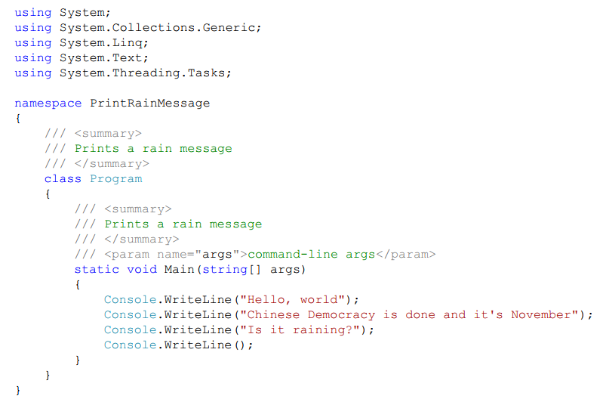
Writing and Running a C# Program

Slide 8
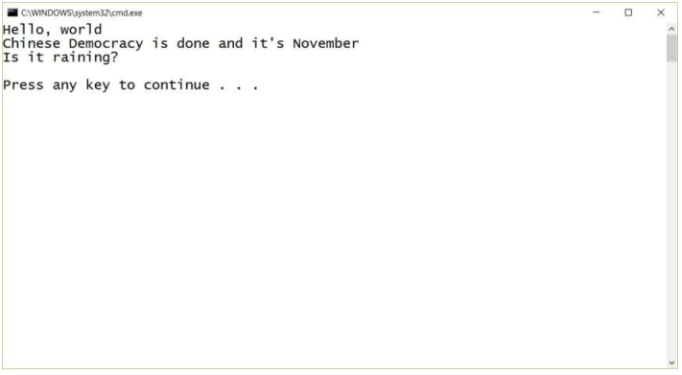
Writing and Running a C# Program
Output

Slide 9
What Does a C# Program Look Like?
C# is an object-oriented language.
Classes are critical part of C# programs.
The Program.cs file contains the application class to run the program.

Slide 10
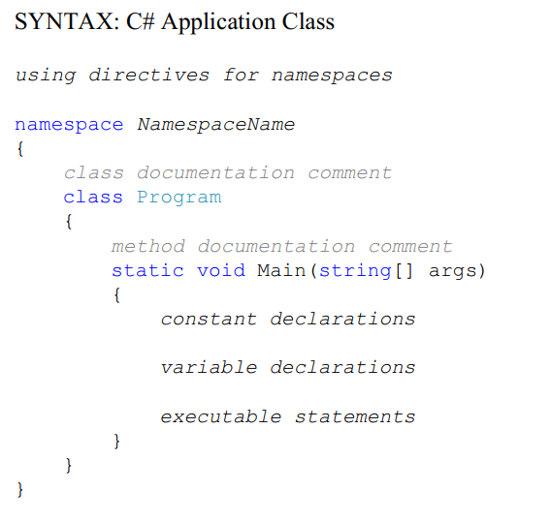
What Does a C# Program Look Like?

Slide 11
What Does a C# Program Look Like?
Items in italics (e.g., class documentation comment) means the programmer decide what goes there.
Words without italics (such as namespace, class, static, and void), need to appear EXACTLY as written.

Slide 12
Using Other Namespaces and Classes
Namespaces and classes are collections of useful C# code that someone else has already written, tested, and debugged.
To access the class of a namespace, we need to use namespace with using directive.
Looking at the documentation to find out namespaces and classes:
Select Help > View Help in Visual Studio to look for information about a specific class or namespace or access https://docs.microsoft.com/en-us/documentation/
Type Random Class into the Search box, and press <Enter>
Unity gives more namespaces to use for developing games.

Slide 13

Namespace/ Comments/ Class/ Identifiers
Namespaces in C# are used to organize too many classes so that it can be easy to handle the application.
Comments that start with three slashes, ///, are called documentation comments; XML tags are used within the documentation comments.
Line comments start with a double slash, //, followed by whatever descriptive text you choose to add after the double slash.
Comment span multiple lines by starting with /*, then ending it with */.

Slide 14
Namespace/ Comments/ Class/ Identifiers
An identifier is used to name something in a program.
Identifiers can contain any number of letters, numbers, and underscores.
They can't start with a number, and they can't contain any spaces.
Identifiers can't be keywords (remember, those special C# words like using, etc.)
Note: C# is case sensitive, which means that the identifier playerName is NOT the same as the identifier playername.

Slide 15
The Main Method
The Main method is the main entry point for the application.
When we run our program, it will simply do the things we told it to do in the Main method.
The syntax description (which the IDE provides in the default template):
(string[] args) called “command-line arguments.

Slide 16


Variables and Constants
Einstein's work:
Energy and mass are the variables in the equation
c (for the speed of light) is a constant in the equation
C# lets us declare the required variables and constants as follows:
We'll get to data types in Module 3.

Slide 17
Console Output
To do our output, we’ll use the Console.Write and Console.WriteLine methods, which are contained in the Console class.
The Console.Write method outputs whatever we tell it to print on a line on the screen and leaves the cursor on that line so we can print more on that line.
The Console.WriteLine method moves the cursor to the next line after printing what we tell it to.

Slide 18
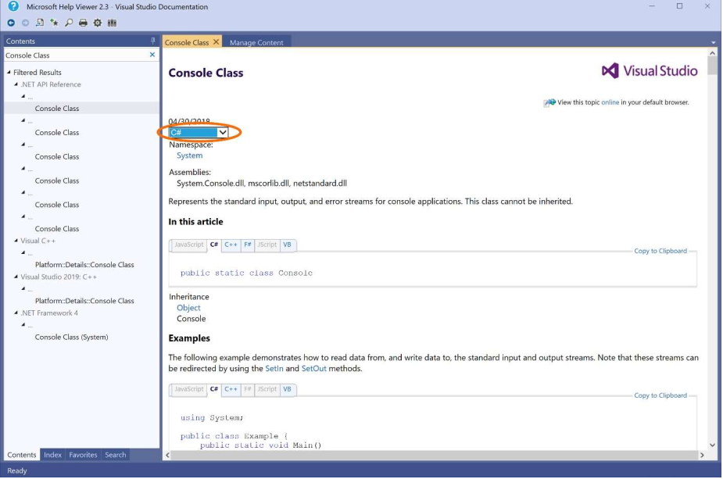
Console Output
Console Class
Document

Slide 19
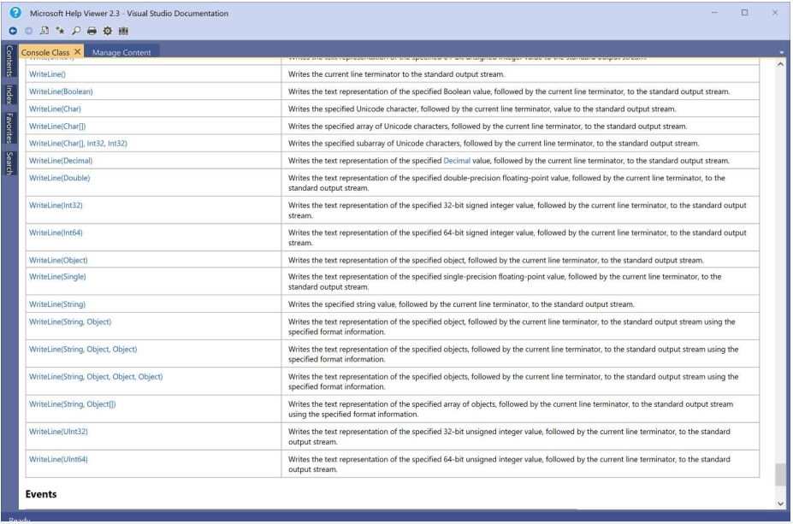
Console Output
Console
WriteLine
Area

Slide 20
Exercise 1: Writing Your First Console Application
Problem 1 – Output your name
Create a new C# Console Application named Exercise1.
Add a line of code that will display your name to the user.
Problem 2 – Output your best friend's or your nemesis' name
Add code to output the name of your best friend or your nemesis.

Slide 21
A Word About Curly Braces
The default Unity scripts don't follow the curly brace placement convention we want to us.
The default line endings in the script template are for Unix (LF only) but Windows uses different line endings (CR and LF).
Follow guide lines in page 25 and 26 to change the content of 81-C# Script-NewBehaviourScript.cs.txt file.

Slide 22
A Matter of Style
Using reasonable, consistent style guidelines will help you develop better code
Variable names
Class names
Indentation

Slide 23
Solving Problems One Step at a Time
How to go from a problem description to the code that solves the problem:
Understand the Problem
Design a Solution
Write Test Cases
Write the Code
Test the Code
Problem solving is an iterative process no matter what set of steps we use.
Notes:
iterative process: quá trình lặp đi lặp lại

Slide 24
Solving Problems One Step at a Time
Understand the Problem
Understanding the problem requires that you understand WHAT is required.
Design a Solution
To figure out HOW you're going to solve the problem.
Designing your solution is one of the hardest problem-solving steps.
This step results in a set of classes, a set of objects, and a set of methods designed to solve the problem.
Write Test Cases
Does your solution do what it's supposed to?
One way to try to make sure a program does what it's supposed to do is with testing.
To accomplish testing, we'll write a set of test cases you run against your code to make sure it's working properly.
Black box test vs While box test, Unit test vs Functional test.

Slide 25
Solving Problems One Step at a Time
Write the Code
This step is where you take your design and implement that design in a working C# program.
The hard part of this step is doing the detailed problem solving to figure out the precise steps you need to implement in your code to solve the problem.
Algorithms
Test the Code
You run your test cases to make sure the program actually behaves the way you expected it to (and the way it's supposed to).
Debug – to find and fix the problems you discover as you test your code. Debugging is a part of every programmer’s life.

Slide 26
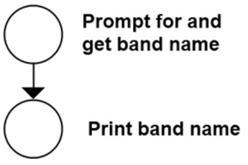

Sequence Control Structure
The simplest problem solutions just start at the beginning and go to the end, one step at a time.
Example: Write an algorithm that will read in the name of a band, then print that name out.
Algorithm:

Slide 27
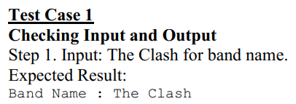
Testing Sequence Control Structures
Testing the code for the problem in the previous example.

Slide 28
Putting It All Together
The print rain message program description: Print the lines: Hello, world Chinese Democracy is done and it's November Is it raining? to the screen.
Understand the Problem
easy to understand.
Design a Solution
using an application class that prints out each line in the message.
Application class: Program
A single method: Main

Slide 29
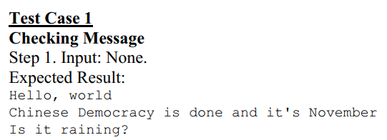
Putting It All Together
Write Test Cases
No inputs, only output

Slide 30
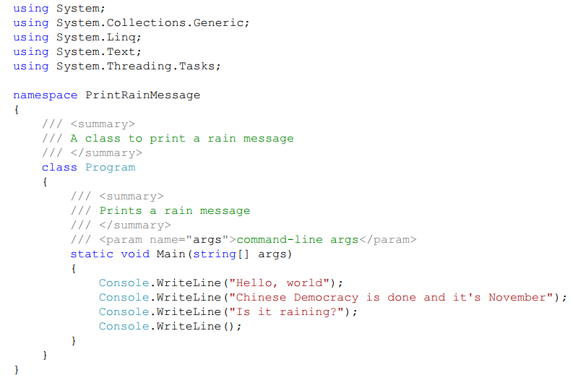
Putting It All Together
Write the Code

Slide 31
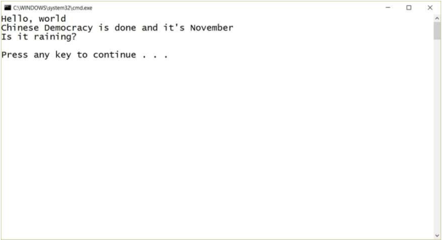
Putting It All Together
Test the Code

Slide 32
Adding a Unity Script
Implement a Unity script that outputs the same message.
Refer to 2.16 in the textbook.

Slide 33
Exercise 2: Writing Your First Unity Script
Problem – Output your favorite three games
Create a new 2D Unity project named Exercise2. Add a scenes folder and save the current scene as scene0. Add a scripts folder and add a new C# script named PrintFavoriteGames. Open the script, fill in the comment near the top of the script, and delete the Update method. Next, add code to the Start method to output the names of your three favorite games. Attach the script to the Main Camera in the scene and run the game to see the output in the Console window.

Slide 34
Summary
Unity documentation.
Write and WriteLine methods.
Display output in the Unity Console window.

